Slide 1
For Live Session
Unit 7

Slide 2
For Live Session: Part 1 (3-5 hours)
In the last unit you used a KNN classifier to classify the passengers who survived and died. Now we will use a Naïve Bayes (NB) classifier and compare the two!
Using all 891 observations, train a NB model with Age and Pclass as predictors and use this model to predict the survival of a 30 year old passenger in the 1, 2 and 3 classes. Use the “type = raw” option to look at the predicted percentage of each outcome. (One slide.)
Split the 891 observations into a training and test set 70% - 30% using this seed and code:
titanicClean = titanic %>% filter(!is.na(Age) & !is.na(Pclass))
set.seed(4)
trainIndices = sample(seq(1:length(titanicClean$Age)),round(.7*length(titanicClean$Age)))
trainTitanic = titanicClean[trainIndices,]
testTitanic = titanicClean[-trainIndices,]
(One slide that shows the head of trainTitanic and testTitanic)
Train a NB model based on the training set using just the Age and Pclass variables. Use the model to predict the survival of those in the test set and use those results to evaluate the model based on accuracy, sensitivity and specificity. Finally, Compare the results to what you found with the KNN classifier. (At least one slide.)
Now repeat the above with a new seed and compare the accuracy, sensitivity and specificity. Do this 3 or 4 times to observe the variance in the statistics. (At least one slide.)
Write a loop to repeat the above for 100 different values of the seed. Find the average of the accuracy, sensitivity and specificity to get a stable (smaller variance) statistic to evaluate the model. (At least one slide.)

Slide 3
For Live Session: Part 1 (3-5 hours)
Now add Sex to the model so that it has Age, Pclass and Sex in the NB model. Use the trainTitanic(set.seed(4)) dataframe to train the model and create a confusion matrix using the testTitanic dataframe. In addition, find the Accuracy, Sensitivity and Specificity. (1 slide)
Again write a loop to get a stable estimate of the accuracy, sensitivity and specificity of this model (using 100 unique seeds). (1 slide)
BONUS: Using the Male and Female KNN from the bonus of Unit 6, combine the two confusion matrices from the Male and Female KNN models to make one confusion matrix and find the accuracy, sensitivity and specificity based on that model. Compare this with the performance of your NB model. Do you prefer one over the other?

Slide 4
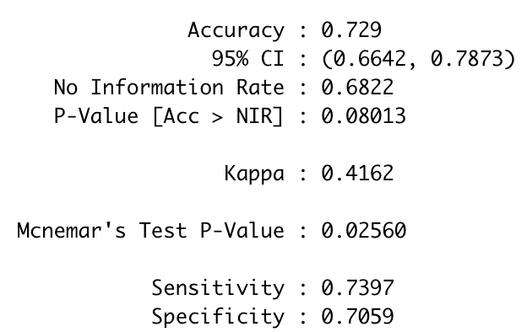
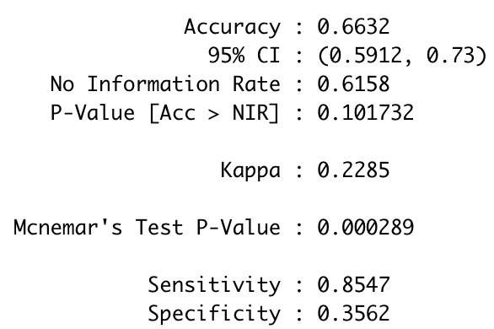
For Live Session: Part 1 (3-5 hours)
Train a NB model based on the training set using just the Age and Pclass variables. Use the model to predict the survival of those in the test set and use those results to evaluate the model based on accuracy, sensitivity and specificity. Finally, Compare the results to what you found with the KNN classifier. (At least one slide.)
NB Classifier
#Note: naiveBayes() requires the response variable to be a factor … Survived is an integer (0,1).
model = naiveBayes(trainTitanic[,c("Age","Pclass")],factor(trainTitanic$Survived, labels = c("No", "Yes")))
table(factor(testTitanic$Survived, labels = c("No", "Yes")),predict(model,testTitanic[,c("Age","Pclass")]))
CM = confusionMatrix(table(factor(testTitanic$Survived, labels = c("No", "Yes")),predict(model,testTitanic[,c("Age","Pclass")])))
CM
KNN Classifier (k = 11)
classifications = knn(trainTitanic[(!is.na(trainTitanic$Age) & !is.na(trainTitanic$Pclass)),c(3,6)],testTitanic[(!is.na(testTitanic$Age) & !is.na(testTitanic$Pclass)),c(3,6)],trainTitanic$Survived[(!is.na(trainTitanic$Age) & !is.na(trainTitanic$Pclass))], prob = TRUE, k = 11)
CM = confusionMatrix(table(classifications,testTitanic$Survived[(!is.na(testTitanic$Age) & !is.na(testTitanic$Pclass))]))
CM

Slide 5
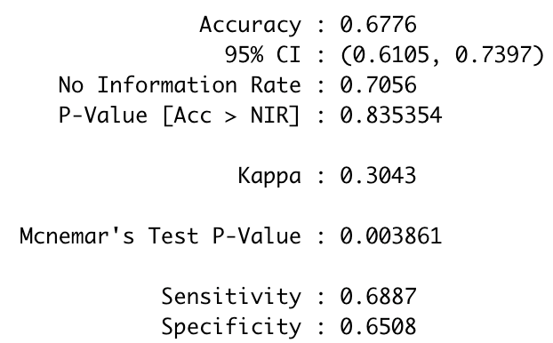
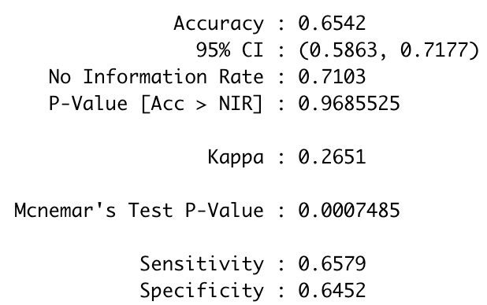
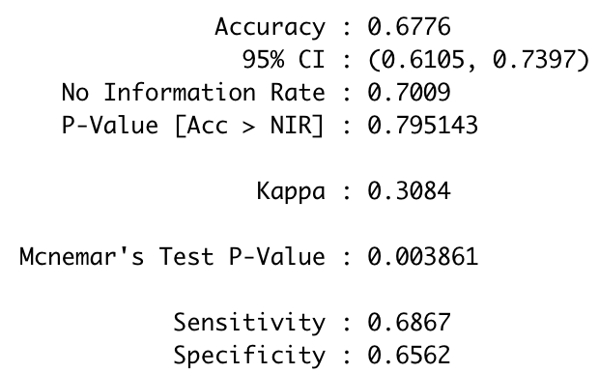
For Live Session: Part 1 (3-5 hours)
Now repeat the above with a new seed and compare the accuracy, sensitivity and specificity. Do this 3 or 4 times to observe the variance in the statistics. (At least one slide.)
set.seed(4)
set.seed(5)
set.seed(6)
set.seed(7)
set.seed(7). # just change the seed number and then run the code to see the variance in the accuracy, specificity and sensitivity
trainIndices = sample(seq(1:length(titanicClean$Age)),round(.7*length(titanicClean$Age)))
trainTitanic = titanicClean[trainIndices,]
testTitanic = titanicClean[-trainIndices,]
model = naiveBayes(trainTitanic[,c("Age","Pclass")],factor(trainTitanic$Survived, labels = c("No", "Yes")))
table(factor(testTitanic$Survived, labels = c("No", "Yes")),predict(model,testTitanic[,c("Age","Pclass")]))
CM = confusionMatrix(table(factor(testTitanic$Survived, labels = c("No", "Yes")),predict(model,testTitanic[,c("Age","Pclass")])))
CM

Slide 6
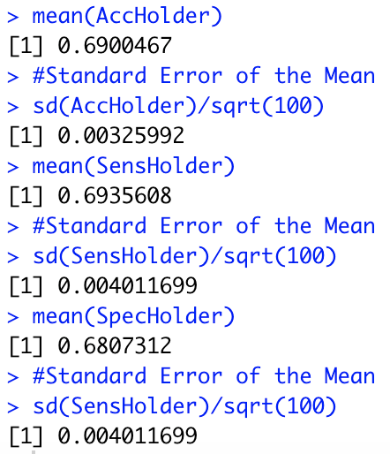
For Live Session: Part 1 (3-5 hours)
In the last unit you used a KNN classifier to classify the passengers who survived and died. Now we will use a Naïve Bayes (NB) classifier and compare the two!
Write a loop to repeat the above for 100 different values of the seed. Find the average of the accuracy, sensitivity and specificity to get a stable (smaller variance) statistic to evaluate the model. (At least one slide.)
AccHolder = numeric(100)
SensHolder = numeric(100)
SpecHolder = numeric(100)
for (seed in 1:100)
{
set.seed(seed)
trainIndices = sample(seq(1:length(titanicClean$Age)),round(.7*length(titanicClean$Age)))
trainTitanic = titanicClean[trainIndices,]
testTitanic = titanicClean[-trainIndices,]
model = naiveBayes(trainTitanic[,c("Age","Pclass")],factor(trainTitanic$Survived, labels = c("No", "Yes")))
table(factor(testTitanic$Survived, labels = c("No", "Yes")),predict(model,testTitanic[,c("Age","Pclass")]))
CM = confusionMatrix(table(factor(testTitanic$Survived, labels = c("No", "Yes")),predict(model,testTitanic[,c("Age","Pclass")])))
AccHolder[seed] = CM$overall[1]
SensHolder[seed] = CM$byClass[1]
SpecHolder[seed] = CM$byClass[2]
}
mean(AccHolder)
sd(AccHolder)
mean(SensHolder)
sd(SensHolder)
mean(SpecHolder)
sd(SensHolder)

Slide 7
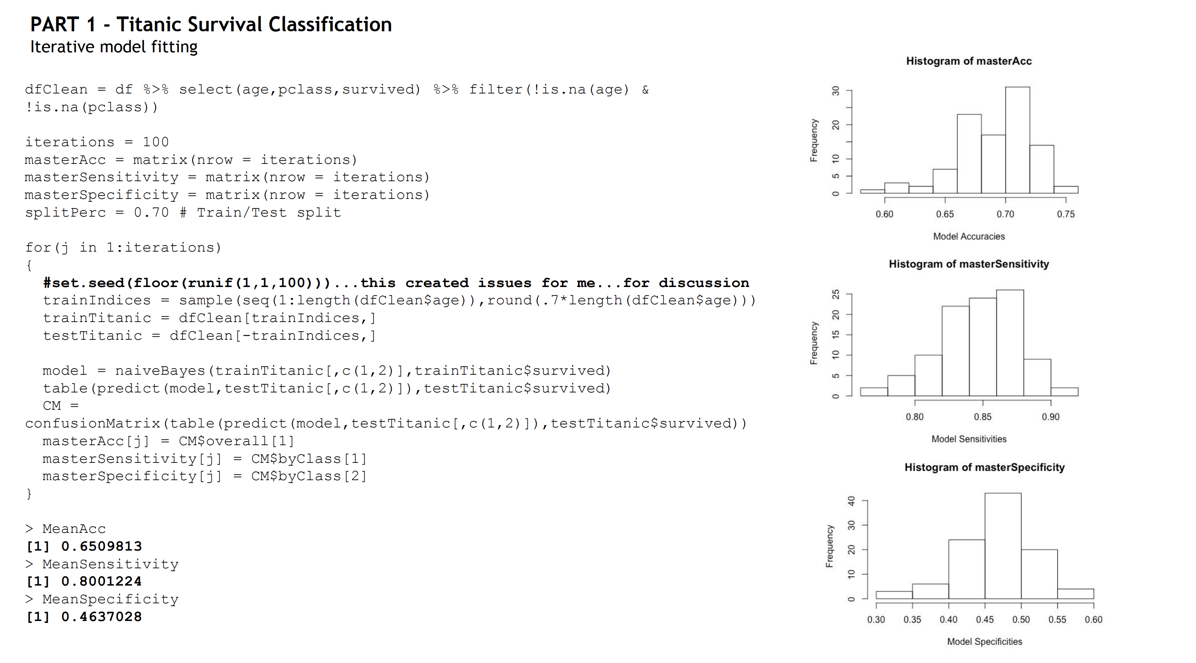

Slide 8
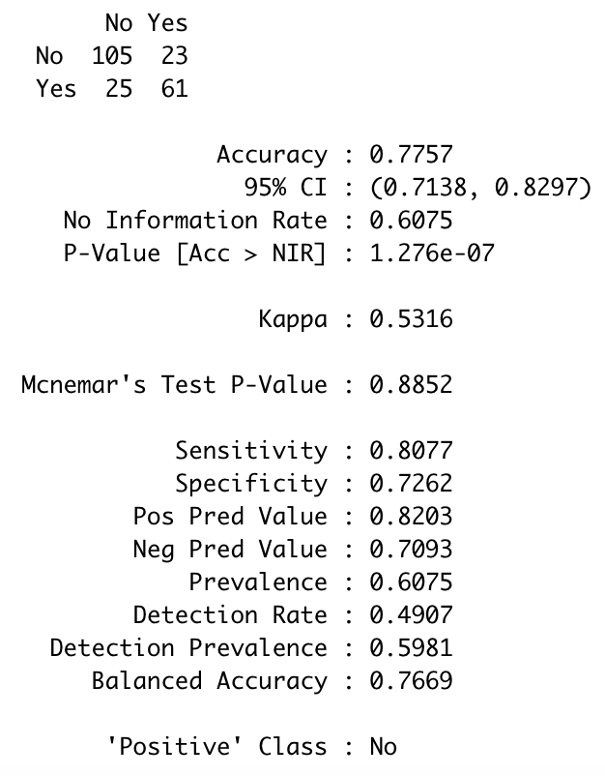
For Live Session: Part 1 (3-5 hours)
Now add Sex to the model so that it has Age, Pclass and Sex in the NB model. Use the trainTitanic(set.seed(4)) dataframe to train the model and create a confusion matrix using the testTitanic dataframe. In addition, find the Accuracy, Sensitivity and Specificity. (1 slide)
#seed = 4
model = naiveBayes(trainTitanic[,c("Sex","Age","Pclass")],factor(trainTitanic$Survived, labels = c("No", "Yes")))
CM = confusionMatrix(table(factor(testTitanic$Survived, labels = c("No", "Yes")),predict(model,testTitanic[,c("Sex","Age","Pclass")])))

Slide 9
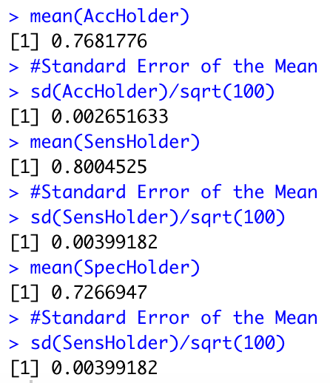
For Live Session: Part 1 (3-5 hours)
Again write a loop to get a stable estimate of the accuracy, sensitivity and specificity of this model (using 100 unique seeds). (1 slide)
AccHolder = numeric(100)
SensHolder = numeric(100)
SpecHolder = numeric(100)
for (seed in 1:100)
{
set.seed(seed)
trainIndices = sample(seq(1:length(titanicClean$Age)),round(.7*length(titanicClean$Age)))
trainTitanic = titanicClean[trainIndices,]
testTitanic = titanicClean[-trainIndices,]
model = naiveBayes(trainTitanic[,c("Sex","Age","Pclass")],factor(trainTitanic$Survived, labels = c("No", "Yes")))
CM = confusionMatrix(table(factor(testTitanic$Survived, labels = c("No", "Yes")),predict(model,testTitanic[,c("Sex","Age","Pclass")])))
AccHolder[seed] = CM$overall[1]
SensHolder[seed] = CM$byClass[1]
SpecHolder[seed] = CM$byClass[2]
}
mean(AccHolder)
sd(AccHolder)
mean(SensHolder)
sd(SensHolder)
mean(SpecHolder)
sd(SensHolder)

Slide 10
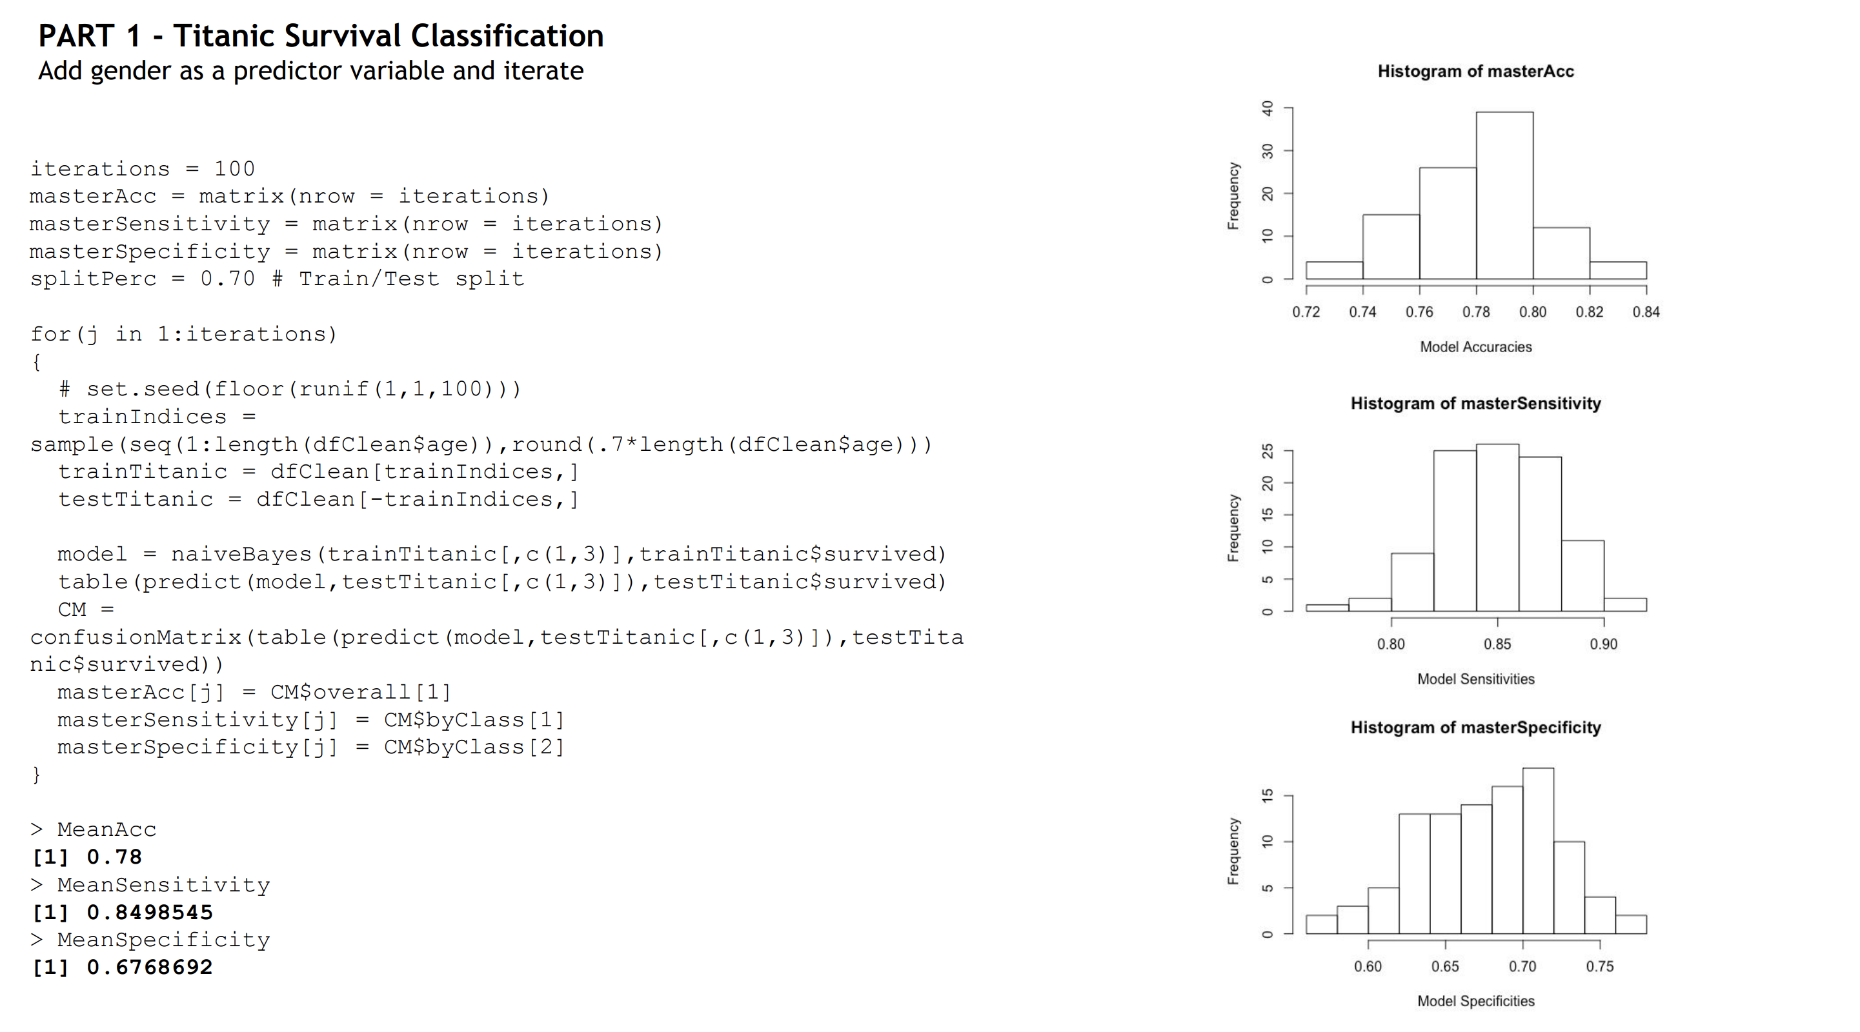

Slide 11
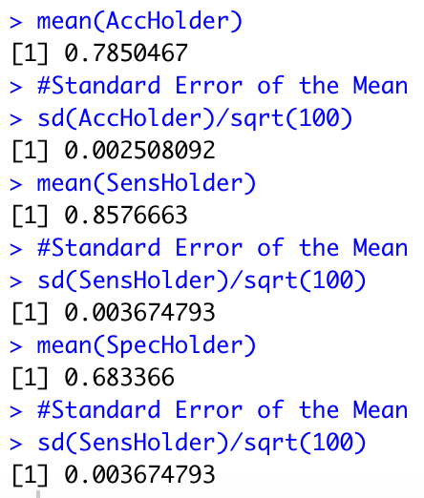
For Live Session: Part 1 (3-5 hours)
BONUS: Using the Male and Female KNN from the bonus of Unit 6, combine the two confusion matrices from the Male and Female KNN models to make one confusion matrix and find the accuracy, sensitivity and specificity based on that model. Compare this with the performance of your NB model. Do you prefer one over the other?
The code below will generate 100 different train/test splits and then take the average of 100 accuracies, sensitivities and specificities. Results are to the right.
# Bonus
AccHolder = numeric(100)
SensHolder = numeric(100)
SpecHolder = numeric(100)
for (seed in 1:100)
{
set.seed(seed)
trainIndices = sample(seq(1:length(titanicClean$Age)),round(.7*length(titanicClean$Age)))
trainTitanic = titanicClean[trainIndices,]
testTitanic = titanicClean[-trainIndices,]
#Male
trainTitanicMale = trainTitanic %>% filter(Sex == "male")
testTitanicMale = testTitanic %>% filter(Sex == "male")
classificationsMale = knn(trainTitanicMale[(!is.na(trainTitanicMale$Age) & !is.na(trainTitanicMale$Pclass)),c(3,6)],testTitanicMale[(!is.na(testTitanicMale$Age) & !is.na(testTitanicMale$Pclass)),c(3,6)],trainTitanicMale$Survived[(!is.na(trainTitanicMale$Age) & !is.na(trainTitanicMale$Pclass))], prob = TRUE, k = 11)
# Female
trainTitanicFemale = trainTitanic %>% filter(Sex == "female")
testTitanicFemale = testTitanic %>% filter(Sex == "female")
classificationsFemale = knn(trainTitanicFemale[(!is.na(trainTitanicFemale$Age) & !is.na(trainTitanicFemale$Pclass)),c(3,6)],testTitanicFemale[(!is.na(testTitanicFemale$Age) & !is.na(testTitanicFemale$Pclass)),c(3,6)],trainTitanicFemale$Survived[(!is.na(trainTitanicFemale$Age) & !is.na(trainTitanicFemale$Pclass))], prob = TRUE, k = 11)
classificationsMF = factor(c(classificationsMale,classificationsFemale), labels = c("No","Yes"))
testM = testTitanicMale[(!is.na(testTitanicMale$Age) & !is.na(testTitanicMale$Pclass)),]
testF = testTitanicFemale[(!is.na(testTitanicFemale$Age) & !is.na(testTitanicFemale$Pclass)),]
testMF = rbind(testM,testF)
table(classificationsMF,testMF$Survived[(!is.na(testMF$Age) & !is.na(testMF$Pclass))])
CM = confusionMatrix(table(classificationsMF,factor(testMF$Survived[(!is.na(testMF$Age) & !is.na(testMF$Pclass))],labels = c("No","Yes"))))
CM
AccHolder[seed] = CM$overall[1]
SensHolder[seed] = CM$byClass[1]
SpecHolder[seed] = CM$byClass[2]
}
mean(AccHolder)
#Standard Error of the Mean
sd(AccHolder)/sqrt(100)
mean(SensHolder)
#Standard Error of the Mean
sd(SensHolder)/sqrt(100)
mean(SpecHolder)
#Standard Error of the Mean
sd(SensHolder)/sqrt(100)

Slide 12
For Live Session: Part 1 (3-5 hours)
BONUS: Using the Male and Female KNN from the bonus of Unit 6, combine the two confusion matrices from the Male and Female KNN models to make one confusion matrix and find the accuracy, sensitivity and specificity based on that model. Compare this with the performance of your NB model. Do you prefer one over the other?
KNN k = 11
Naïve Bayes

Slide 13
For Live Session: Part 2 (1 – 3 hours)
a. For the full (multinomial) IRIS data (the iris dataset in R), do a 70-30 train/test cross validation and use sepal length and width as predictors. Generate 100 different train/test splits and calculate the average accuracy, sensitivity and specificity. Compare the average accuracy to that to the KNN model you used in Unit 6.

Slide 14
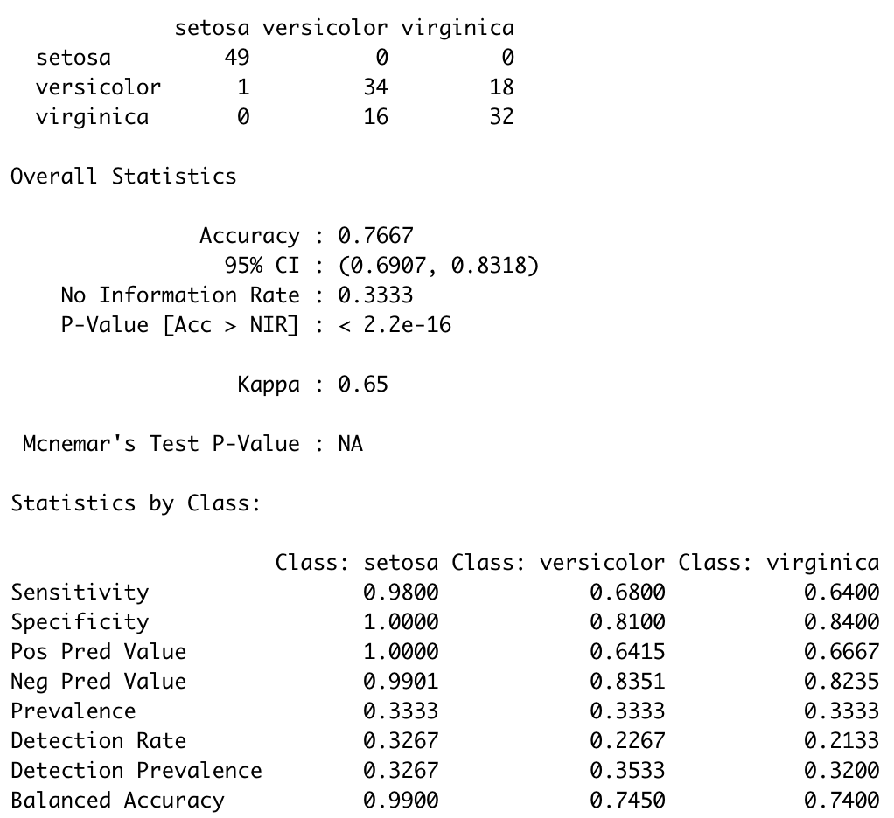
Multi-class Specificity and Sensitivity
Sensitivity for each class is the percent of that class that was classified correctly.
Specificity for Class X is the percentage of elements not in that class that were correctly classified as not being in that class (Class X).
Example:
Specificity:
Setosa: (34+16+18+32)/100
Versicolor: (49+32) / 100
Virginica: (49+1+34)/100

Slide 15
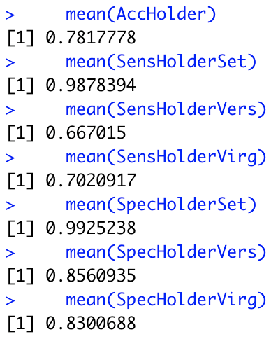
For Live Session: Part 2 (1 – 3 hours)
# Code for NB part
iterations = 100
AccHolder = numeric(100)
SensHolderSet = numeric(100)
SensHolderVers = numeric(100)
SensHolderVirg = numeric(100)
SpecHolderSet = numeric(100)
SpecHolderVers = numeric(100)
SpecHolderVirg = numeric(100)
for(seed in 1:iterations)
{
set.seed(seed)
trainIndices = sample(seq(1:150),round(.7*150))
irisTrain = iris[trainIndices,]
irisTest = iris[-trainIndices,]
model = naiveBayes(irisTrain[,c(1,2)],irisTrain[,5])
CM = confusionMatrix(table(irisTest$Species,predict(model,irisTest[,c(1,2)])))
AccHolder[seed] = CM$overall[1]
SensHolderSet[seed] = CM$byClass[,1][1]
SensHolderVers[seed] = CM$byClass[,1][2]
SensHolderVirg[seed] = CM$byClass[,1][3]
SpecHolderSet[seed] = CM$byClass[,2][1]
SpecHolderVers[seed] = CM$byClass[,2][2]
SpecHolderVirg[seed] = CM$byClass[,2][3]
}
mean(AccHolder)
mean(SensHolderSet)
mean(SensHolderVers)
mean(SensHolderVirg)
mean(SpecHolderSet)
mean(SpecHolderVers)
mean(SpecHolderVirg)
a. For the full (multinomial) IRIS data (the iris dataset in R), do a 70-30 train/test cross validation and use sepal length and width as predictors. Generate 100 different train/test splits and calculate the average accuracy, sensitivity and specificity. Compare the average accuracy to that to the KNN model you used in Unit 6.
My KNN model from Unit 6 (k = 20) with leave 1 out CV.
Average of 100 NB models

Slide 16
For Live Session: BONUS
Use the NYT News/Other Classifier code to analyze stories about Trump last month (search term “Trump”). We would like to build a classifier that will classify between news stories and other and we would like to compare two models: one that uses the headline and one that uses the snippet. Compare these two models based on sensitivity and specificity and provide at least one plot to help you visualize the results.

Slide 17
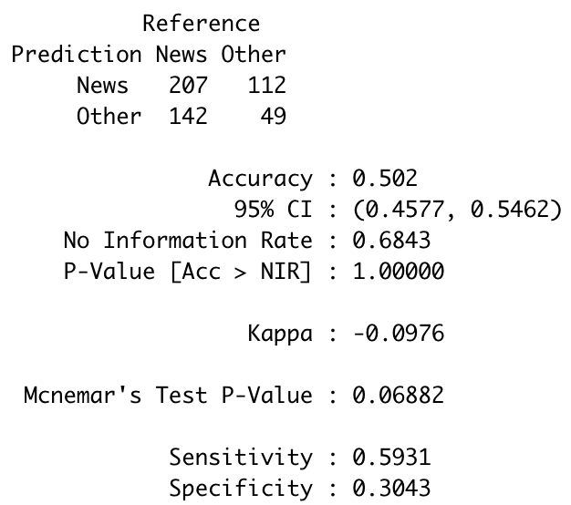
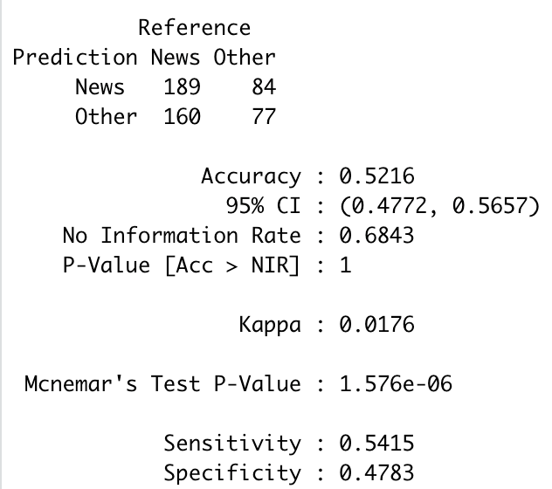
Naïve Bayes: News v. Other and Trump NYT Data
######################
# Loading the Data from the NYT API
# We will load from "Data+Science" and "Trump" searches.
# Data+Science Search
# term <- "Data+Science" # Need to use + to string together separate words
# begin_date <- "20180901"
# end_date <- "20190502"
# Trump Search
# term <- "Trump" # Need to use + to string together separate words
# begin_date <- "20190415"
# end_date <- "20190502"
######################
#NYT Example
library(tm) #text mining library provides the stopwords() function
library(tidyr)
library(plyr)
library(jsonlite)
library(dplyr)
library(tidyverse)
NYTIMES_KEY = "OG89fUubcS8FXofVrLA4dmIOHh5omiFa" #Your Key Here … get from NTY API website
# Let's set some parameters
term <- "Trump" # Need to use + to string together separate words
begin_date <- "20190901"
end_date <- "20190930"
baseurl <- paste0("http://api.nytimes.com/svc/search/v2/articlesearch.json?q=",term,
"&begin_date=",begin_date,"&end_date=",end_date,
"&facet_filter=true&api-key=",NYTIMES_KEY, sep="")
baseurl
initialQuery <- jsonlite::fromJSON(baseurl)
maxPages <- round((initialQuery$response$meta$hits[1] / 10)-1)
maxPages
pages <- list()
for(i in 0:maxPages){
nytSearch <- jsonlite::fromJSON(paste0(baseurl, "&page=", i), flatten = TRUE) %>% data.frame()
message("Retrieving page ", i)
pages[[i+1]] <- nytSearch
Sys.sleep(7)
}
allNYTSearch <- rbind_pages(pages)
#Segmentation
# Visualize coverage by section
allNYTSearch %>%
group_by(response.docs.type_of_material) %>%
dplyr::summarize(count=n()) %>%
mutate(percent = (count / sum(count))*100) %>%
ggplot() +
geom_bar(aes(y=percent, x=response.docs.type_of_material, fill=response.docs.type_of_material), stat = "identity") + coord_flip()
#Make another column of News versus Other ... The labels
allNYTSearch$NewsOrOther = ifelse(allNYTSearch$response.docs.type_of_material == "News","News","Other")
#There is an NA in NewsOrOther
# Visualize coverage of News or Other
allNYTSearch[!is.na(allNYTSearch$NewsOrOther),] %>%
group_by(NewsOrOther) %>%
dplyr::summarize(count=n()) %>%
mutate(percent = (count / sum(count))*100) %>%
ggplot() +
geom_bar(aes(y=percent, x=NewsOrOther, fill=NewsOrOther), stat = "identity") + coord_flip()
#Train and Test Split 70%/30%
set.seed(2)
trainInd = sample(seq(1,dim(allNYTSearch)[1],1),round(.7*dim(allNYTSearch)[1]))
allNYTSearchTrain = allNYTSearch[trainInd,]
allNYTSearchTest = allNYTSearch[-trainInd,]
#This function returns P(News | Keyword)
#P(News|KW) = P(KW|News)* P(News) / P(KW)
Pnews_word = function(key_word, trainingSet, alphaLaplace = 1, betaLaplace = 1) # alpha and beta are for laplace smoothing
{
trainingSet$response.docs.headline.main = unlist(str_replace_all(trainingSet$response.docs.snippet,"[^[:alnum:] ]", "")) #Take out all but alpha numeric characters from training headlines
#print(key_word)
NewsGroup = trainingSet[trainingSet$NewsOrOther == "News",]
OtherGroup = trainingSet[trainingSet$NewsOrOther == "Other",]
pNews = dim(NewsGroup)[1] / (dim(NewsGroup)[1] + dim(OtherGroup)[1])
pOther = 1 - pNews
pKWGivenNews = (length(str_which(NewsGroup$response.docs.snippet,regex(str_c("\\b",key_word,"\\b",sep=""),ignore.case = TRUE)))+alphaLaplace)/(dim(NewsGroup)[1]+betaLaplace)
pKWGivenOther = (length(str_which(OtherGroup$response.docs.snippet,regex(str_c("\\b",key_word,"\\b",sep=""),ignore.case = TRUE)))+alphaLaplace)/(dim(OtherGroup)[1]+betaLaplace)
pKW = length(str_which(trainingSet$response.docs.snippet,regex(str_c("\\b",key_word,"\\b",sep=""),ignore.case = TRUE)))/dim(trainingSet)[1]
pNewsGivenKW = pKWGivenNews*pNews/pKW
pOtherGivenKW = pKWGivenOther*pOther/pKW
return(pNewsGivenKW)
}
theScoreHolderNews = c()
theScoreHolderOther = c()
articleScoreNews = 0;
articleScoreOther = 0;
for (i in 1 : dim(allNYTSearchTest)[1]) #This loop iterates over the articles in the Test Set
{
articleScoreNews = 1;
articleScoreOther = 1;
#The [^[:alnum:] ] replaces all non alphanumeric characters with nulls.
theText = unlist(str_split(str_replace_all(allNYTSearchTest[i,]$response.docs.snippet,"[^[:alnum:] ]", ""), stringr::boundary("word"))) #Take out all but alpha numeric characters from search string ... theText holds each word in the headline as its own word.
# stopwords() #from package tm
wordsToTakeOut = stopwords()
# put word boundaries stopwords so that we don't detect partial words later
wordsToTakeOut = str_c(wordsToTakeOut,collapse = "\\b|\\b")
wordsToTakeOut = str_c("\\b",wordsToTakeOut,"\\b")
#wordsToTakeOut
importantWords = theText[!str_detect(theText,regex(wordsToTakeOut,ignore_case = TRUE))]
#importantWords
for(j in 1 : length(importantWords)) #This loop iterates over the important words in the headline
{
articleScoreNews = articleScoreNews * Pnews_word(importantWords[j],allNYTSearchTrain)
articleScoreOther = articleScoreOther * (1 - Pnews_word(importantWords[j],allNYTSearchTrain))
}
theScoreHolderNews[i] = articleScoreNews
theScoreHolderOther[i] = articleScoreOther
}
# Classify the aricle as News or Other based on a given piece of information from the article.
allNYTSearchTest$Classified = ifelse(theScoreHolderNews > theScoreHolderOther,"News","Other")
#Confusion Matrix
table(allNYTSearchTest$Classified,allNYTSearchTest$NewsOrOther) #Actual in Columns
confusionMatrix(factor(allNYTSearchTest$Classified),factor(allNYTSearchTest$NewsOrOther))
######################
# Loading the Data from the NYT API
# We will load from "Data+Science" and "Trump" searches.
# Data+Science Search
# term <- "Data+Science" # Need to use + to string together separate words
# begin_date <- "20180901"
# end_date <- "20190502"
# Trump Search
# term <- "Trump" # Need to use + to string together separate words
# begin_date <- "20190415"
# end_date <- "20190502"
######################
#NYT Example
library(tm) #text mining library provides the stopwords() function
library(tidyr)
library(plyr)
library(jsonlite)
library(dplyr)
library(tidyverse)
NYTIMES_KEY = "OG89fUubcS8FXofVrLA4dmIOHh5omiFa" #Your Key Here … get from NTY API website
# Let's set some parameters
term <- "Trump" # Need to use + to string together separate words
begin_date <- "20190901"
end_date <- "20190930"
baseurl <- paste0("http://api.nytimes.com/svc/search/v2/articlesearch.json?q=",term,
"&begin_date=",begin_date,"&end_date=",end_date,
"&facet_filter=true&api-key=",NYTIMES_KEY, sep="")
baseurl
initialQuery <- jsonlite::fromJSON(baseurl)
maxPages <- round((initialQuery$response$meta$hits[1] / 10)-1)
maxPages
pages <- list()
for(i in 0:maxPages){
nytSearch <- jsonlite::fromJSON(paste0(baseurl, "&page=", i), flatten = TRUE) %>% data.frame()
message("Retrieving page ", i)
pages[[i+1]] <- nytSearch
Sys.sleep(7)
}
allNYTSearch <- rbind_pages(pages)
#Segmentation
# Visualize coverage by section
allNYTSearch %>%
group_by(response.docs.type_of_material) %>%
dplyr::summarize(count=n()) %>%
mutate(percent = (count / sum(count))*100) %>%
ggplot() +
geom_bar(aes(y=percent, x=response.docs.type_of_material, fill=response.docs.type_of_material), stat = "identity") + coord_flip()
#Make another column of News versus Other ... The labels
allNYTSearch$NewsOrOther = ifelse(allNYTSearch$response.docs.type_of_material == "News","News","Other")
#There is an NA in NewsOrOther
# Visualize coverage of News or Other
allNYTSearch[!is.na(allNYTSearch$NewsOrOther),] %>%
group_by(NewsOrOther) %>%
dplyr::summarize(count=n()) %>%
mutate(percent = (count / sum(count))*100) %>%
ggplot() +
geom_bar(aes(y=percent, x=NewsOrOther, fill=NewsOrOther), stat = "identity") + coord_flip()
#Train and Test Split 70%/30%
set.seed(2)
trainInd = sample(seq(1,dim(allNYTSearch)[1],1),round(.7*dim(allNYTSearch)[1]))
allNYTSearchTrain = allNYTSearch[trainInd,]
allNYTSearchTest = allNYTSearch[-trainInd,]
#This function returns P(News | Keyword)
#P(News|KW) = P(KW|News)* P(News) / P(KW)
Pnews_word = function(key_word, trainingSet, alphaLaplace = 1, betaLaplace = 1) # alpha and beta are for laplace smoothing
{
trainingSet$response.docs.headline.main = unlist(str_replace_all(trainingSet$response.docs.snippet,"[^[:alnum:] ]", "")) #Take out all but alpha numeric characters from training headlines
#print(key_word)
NewsGroup = trainingSet[trainingSet$NewsOrOther == "News",]
OtherGroup = trainingSet[trainingSet$NewsOrOther == "Other",]
pNews = dim(NewsGroup)[1] / (dim(NewsGroup)[1] + dim(OtherGroup)[1])
pOther = 1 - pNews
pKWGivenNews = (length(str_which(NewsGroup$response.docs.snippet,regex(str_c("\\b",key_word,"\\b",sep=""),ignore.case = TRUE)))+alphaLaplace)/(dim(NewsGroup)[1]+betaLaplace)
pKWGivenOther = (length(str_which(OtherGroup$response.docs.snippet,regex(str_c("\\b",key_word,"\\b",sep=""),ignore.case = TRUE)))+alphaLaplace)/(dim(OtherGroup)[1]+betaLaplace)
pKW = length(str_which(trainingSet$response.docs.snippet,regex(str_c("\\b",key_word,"\\b",sep=""),ignore.case = TRUE)))/dim(trainingSet)[1]
pNewsGivenKW = pKWGivenNews*pNews/pKW
pOtherGivenKW = pKWGivenOther*pOther/pKW
return(pNewsGivenKW)
}
theScoreHolderNews = c()
theScoreHolderOther = c()
articleScoreNews = 0;
articleScoreOther = 0;
for (i in 1 : dim(allNYTSearchTest)[1]) #This loop iterates over the articles in the Test Set
{
articleScoreNews = 1;
articleScoreOther = 1;
#The [^[:alnum:] ] replaces all non alphanumeric characters with nulls.
theText = unlist(str_split(str_replace_all(allNYTSearchTest[i,]$response.docs.snippet,"[^[:alnum:] ]", ""), stringr::boundary("word"))) #Take out all but alpha numeric characters from search string ... theText holds each word in the headline as its own word.
# stopwords() #from package tm
wordsToTakeOut = stopwords()
# put word boundaries stopwords so that we don't detect partial words later
wordsToTakeOut = str_c(wordsToTakeOut,collapse = "\\b|\\b")
wordsToTakeOut = str_c("\\b",wordsToTakeOut,"\\b")
#wordsToTakeOut
importantWords = theText[!str_detect(theText,regex(wordsToTakeOut,ignore_case = TRUE))]
#importantWords
for(j in 1 : length(importantWords)) #This loop iterates over the important words in the headline
{
articleScoreNews = articleScoreNews * Pnews_word(importantWords[j],allNYTSearchTrain)
articleScoreOther = articleScoreOther * (1 - Pnews_word(importantWords[j],allNYTSearchTrain))
}
theScoreHolderNews[i] = articleScoreNews
theScoreHolderOther[i] = articleScoreOther
}
# Classify the aricle as News or Other based on a given piece of information from the article.
allNYTSearchTest$Classified = ifelse(theScoreHolderNews > theScoreHolderOther,"News","Other")
#Confusion Matrix
table(allNYTSearchTest$Classified,allNYTSearchTest$NewsOrOther) #Actual in Columns
confusionMatrix(factor(allNYTSearchTest$Classified),factor(allNYTSearchTest$NewsOrOther))
######################
# Loading the Data from the NYT API
# We will load from "Data+Science" and "Trump" searches.
# Data+Science Search
# term <- "Data+Science" # Need to use + to string together separate words
# begin_date <- "20180901"
# end_date <- "20190502"
# Trump Search
# term <- "Trump" # Need to use + to string together separate words
# begin_date <- "20190415"
# end_date <- "20190502"
######################
#NYT Example
library(tm) #text mining library provides the stopwords() function
library(tidyr)
library(plyr)
library(jsonlite)
library(dplyr)
library(tidyverse)
NYTIMES_KEY = "OG89fUubcS8FXofVrLA4dmIOHh5omiFa" #Your Key Here … get from NTY API website
# Let's set some parameters
term <- "Trump" # Need to use + to string together separate words
begin_date <- "20190901"
end_date <- "20190930"
baseurl <- paste0("http://api.nytimes.com/svc/search/v2/articlesearch.json?q=",term,
"&begin_date=",begin_date,"&end_date=",end_date,
"&facet_filter=true&api-key=",NYTIMES_KEY, sep="")
baseurl
initialQuery <- jsonlite::fromJSON(baseurl)
maxPages <- round((initialQuery$response$meta$hits[1] / 10)-1)
maxPages
pages <- list()
for(i in 0:maxPages){
nytSearch <- jsonlite::fromJSON(paste0(baseurl, "&page=", i), flatten = TRUE) %>% data.frame()
message("Retrieving page ", i)
pages[[i+1]] <- nytSearch
Sys.sleep(7)
}
allNYTSearch <- rbind_pages(pages)
#Segmentation
# Visualize coverage by section
allNYTSearch %>%
group_by(response.docs.type_of_material) %>%
dplyr::summarize(count=n()) %>%
mutate(percent = (count / sum(count))*100) %>%
ggplot() +
geom_bar(aes(y=percent, x=response.docs.type_of_material, fill=response.docs.type_of_material), stat = "identity") + coord_flip()
#Make another column of News versus Other ... The labels
allNYTSearch$NewsOrOther = ifelse(allNYTSearch$response.docs.type_of_material == "News","News","Other")
#There is an NA in NewsOrOther
# Visualize coverage of News or Other
allNYTSearch[!is.na(allNYTSearch$NewsOrOther),] %>%
group_by(NewsOrOther) %>%
dplyr::summarize(count=n()) %>%
mutate(percent = (count / sum(count))*100) %>%
ggplot() +
geom_bar(aes(y=percent, x=NewsOrOther, fill=NewsOrOther), stat = "identity") + coord_flip()
#Train and Test Split 70%/30%
set.seed(2)
trainInd = sample(seq(1,dim(allNYTSearch)[1],1),round(.7*dim(allNYTSearch)[1]))
allNYTSearchTrain = allNYTSearch[trainInd,]
allNYTSearchTest = allNYTSearch[-trainInd,]
#This function returns P(News | Keyword)
#P(News|KW) = P(KW|News)* P(News) / P(KW)
Pnews_word = function(key_word, trainingSet, alphaLaplace = 1, betaLaplace = 1) # alpha and beta are for laplace smoothing
{
trainingSet$response.docs.headline.main = unlist(str_replace_all(trainingSet$response.docs.snippet,"[^[:alnum:] ]", "")) #Take out all but alpha numeric characters from training headlines
#print(key_word)
NewsGroup = trainingSet[trainingSet$NewsOrOther == "News",]
OtherGroup = trainingSet[trainingSet$NewsOrOther == "Other",]
pNews = dim(NewsGroup)[1] / (dim(NewsGroup)[1] + dim(OtherGroup)[1])
pOther = 1 - pNews
pKWGivenNews = (length(str_which(NewsGroup$response.docs.snippet,regex(str_c("\\b",key_word,"\\b",sep=""),ignore.case = TRUE)))+alphaLaplace)/(dim(NewsGroup)[1]+betaLaplace)
pKWGivenOther = (length(str_which(OtherGroup$response.docs.snippet,regex(str_c("\\b",key_word,"\\b",sep=""),ignore.case = TRUE)))+alphaLaplace)/(dim(OtherGroup)[1]+betaLaplace)
pKW = length(str_which(trainingSet$response.docs.snippet,regex(str_c("\\b",key_word,"\\b",sep=""),ignore.case = TRUE)))/dim(trainingSet)[1]
pNewsGivenKW = pKWGivenNews*pNews/pKW
pOtherGivenKW = pKWGivenOther*pOther/pKW
return(pNewsGivenKW)
}
theScoreHolderNews = c()
theScoreHolderOther = c()
articleScoreNews = 0;
articleScoreOther = 0;
for (i in 1 : dim(allNYTSearchTest)[1]) #This loop iterates over the articles in the Test Set
{
articleScoreNews = 1;
articleScoreOther = 1;
#The [^[:alnum:] ] replaces all non alphanumeric characters with nulls.
theText = unlist(str_split(str_replace_all(allNYTSearchTest[i,]$response.docs.snippet,"[^[:alnum:] ]", ""), stringr::boundary("word"))) #Take out all but alpha numeric characters from search string ... theText holds each word in the headline as its own word.
# stopwords() #from package tm
wordsToTakeOut = stopwords()
# put word boundaries stopwords so that we don't detect partial words later
wordsToTakeOut = str_c(wordsToTakeOut,collapse = "\\b|\\b")
wordsToTakeOut = str_c("\\b",wordsToTakeOut,"\\b")
#wordsToTakeOut
importantWords = theText[!str_detect(theText,regex(wordsToTakeOut,ignore_case = TRUE))]
#importantWords
for(j in 1 : length(importantWords)) #This loop iterates over the important words in the headline
{
articleScoreNews = articleScoreNews * Pnews_word(importantWords[j],allNYTSearchTrain)
articleScoreOther = articleScoreOther * (1 - Pnews_word(importantWords[j],allNYTSearchTrain))
}
theScoreHolderNews[i] = articleScoreNews
theScoreHolderOther[i] = articleScoreOther
}
# Classify the aricle as News or Other based on a given piece of information from the article.
allNYTSearchTest$Classified = ifelse(theScoreHolderNews > theScoreHolderOther,"News","Other")
#Confusion Matrix
table(allNYTSearchTest$Classified,allNYTSearchTest$NewsOrOther) #Actual in Columns
confusionMatrix(factor(allNYTSearchTest$Classified),factor(allNYTSearchTest$NewsOrOther))
With Headline
With Snippet

Slide 18
PROS AND CONS
K-Nearest Neighbors (KNN)
Pros:
Simplicity: KNN is simple to understand and implement. It doesn’t require any assumptions about the data distribution.
No Training Phase: KNN is a lazy learner, meaning it doesn’t involve an explicit training phase. The entire dataset is used during prediction.
Adaptability: It can handle multi-class classification problems and is versatile in terms of distance metrics (e.g., Euclidean, Manhattan).
Non-Parametric: KNN makes no assumptions about the underlying data distribution, making it suitable for complex datasets with arbitrary decision boundaries.
Cons:
Computationally Expensive: Prediction time can be slow, especially with large datasets, because it requires calculating the distance between the query and all training samples.
Memory Intensive: KNN requires storing the entire dataset, which can be impractical for large datasets.
3.Choice of K and Distance Metric: The performance of KNN heavily depends on the choice of K (number of neighbors) and the distance metric, which may require cross-validation to optimize.
Naive Bayes
Pros:
Fast and Efficient: Naive Bayes is computationally efficient, with both training and prediction being very fast.
Less Data Requirement: It performs well with small datasets and can handle high-dimensional data well.
Probabilistic Interpretation: Naive Bayes provides probabilistic predictions, which can be useful for certain applications requiring a degree of confidence.
Handles Missing Data: It can handle missing data by simply ignoring the missing values during probability estimation.
5.Variety of Predictors: Naive Bayes works well with categorical, numerical and text predictors.
Cons:
Assumption of Independence: The core assumption of Naive Bayes is that features are independent given the class label, which is often not true in real-world data. This can limit its effectiveness when features are correlated.
Zero Probability Problem: If a feature-category combination was not observed in the training set, it will result in zero probability during prediction. This is often mitigated by techniques like Laplace smoothing.

Slide 19

Break Out!
There is a package in R called ISLR that has a dataset in it called Smarket. This data set is the daily percentage returns for the S&P 500 stock index between 2001 and 2005.
You goal is to try and develop (and evaluate) a model that will help you predict (classify) whether there will be a net positive or negative gain for a given day using only the information that would be available before that day.
Come up with a NB model and a KNN model as well if you have time. Evaluate the performance of your model with a confusion matrix, accuracy, sensitivity and specificity on a 30% hold out set.
Try and make a PowerPoint slide or two to summarize your findings. Try and make this as presentation quality as you can.

Slide 21

Appendix
Great question.... the goal of our class is to learn, understand each concept and sometimes, most times, this requires some sort of "struggle" ... but is designed to result in understanding. In our educational setting, the class is designed to first do, struggle, learn, see the errors that result to understand the models, coding, practical issues, etc and then use ChatGPT to see what it can provide and its strengths and weaknesses. Many students use ChatGPT first and if it works that is it... and they really don't know if it works, they just know that it ran since they don't know what to expect because they don't understand the method and what to expect. In these cases is ChatGPT doesn't work, then that is it, they report that it doesn't work and are many times frustrated and move on. You on the other hand, ran into a problem with the code ChatGPT produced, added a line, and were happy with the result... that is, you used it to supplement your skills rather than make up for a lack of skills. In this class, the pedagogy is to learn, practice, struggle, learn, think, struggle, understand, repeat and then use ChatGPT ... in this way it amplifies your abilities.

